Slide 1
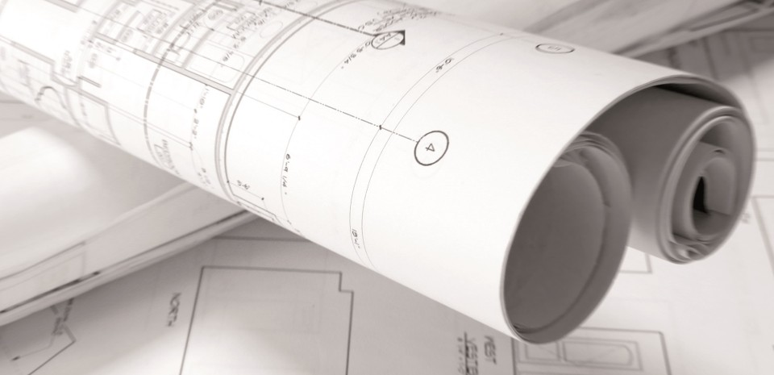
Construction
Designation
SONGLIM CNF

Slide 2
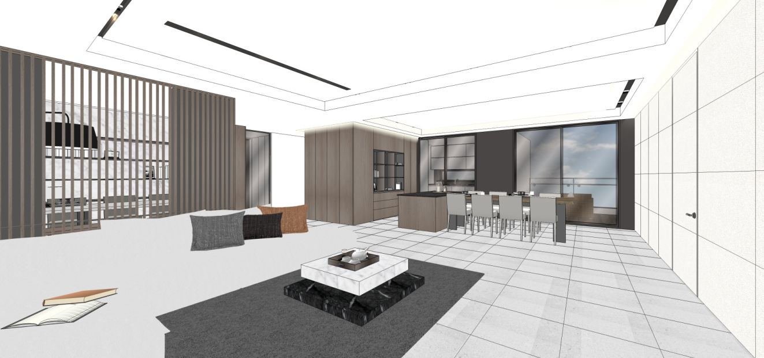
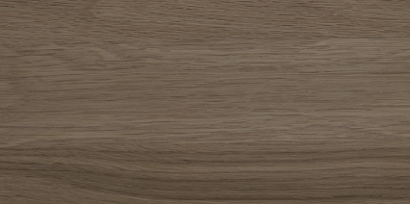
Company
Overview
Company: SONGLIM CNF Inc.
CEO: Jong Hoon, Seon
Head Office: 25-18 Eco Jungang-ro, Namdong-gu
Incheon, South Korea
Production Plant: 357, Ganghwa Dong Ro, Bulmyun,
Incheon, South Korea
Plant Scale: Factory Site 5,844㎡
Production Plant 2,500㎡
Products: Built-in kitchen cabinets and storage
furniture for apartment complex. Built-in
furniture for hotel and hospital facilities
Characteristics: From research and development to
production and quality control, we maintain
strict inspections to deliver the best
final products for our customers.

Slide 3
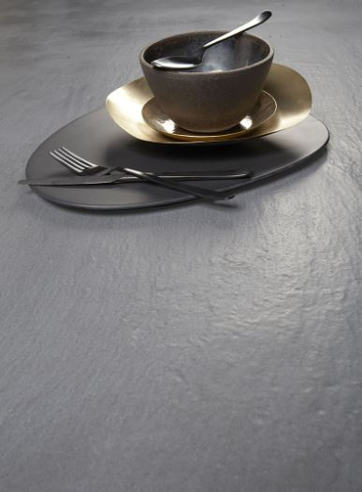
Company History
2016 . 07
-Established SONGLIM CNF Inc.
2021. 01
-Domestic distributor of
MOBILCLAN
(Italian Brand kitchen furniture)
2022. 02
Domestic distributor of
Vadara
(USA premium countertop)
2022 .08
Established Manufacture Factory

Slide 4
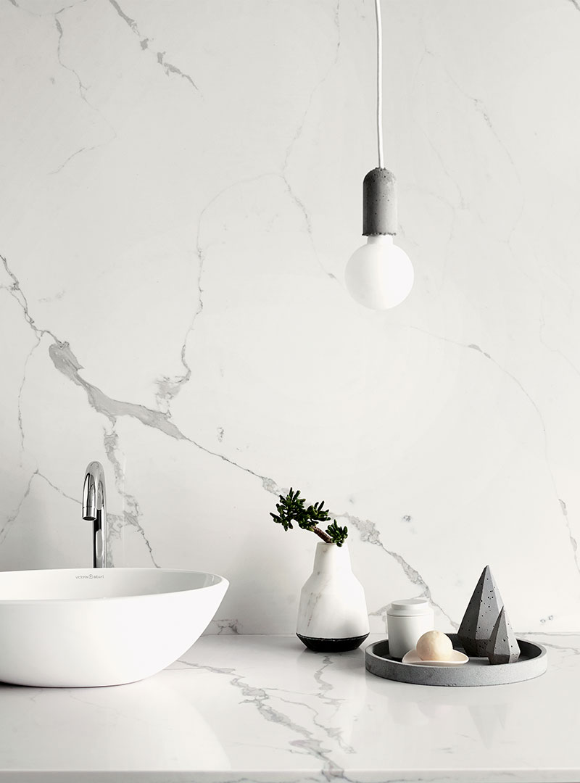
Organization Chart
President
-Jong Ju, Kim
CEO
-Jong Hoon, Seon
Sales Dept
-Furniture Department
-Countertop Department
-On-site Management
Product Dept
-Manufacture Management
-Production-site Management
-Customer Service Department
Business
Support
-Sales Team
-Management Team
-Financial Team
Research Dept
-Product Research Team
-Furnishing Design Team

Slide 5
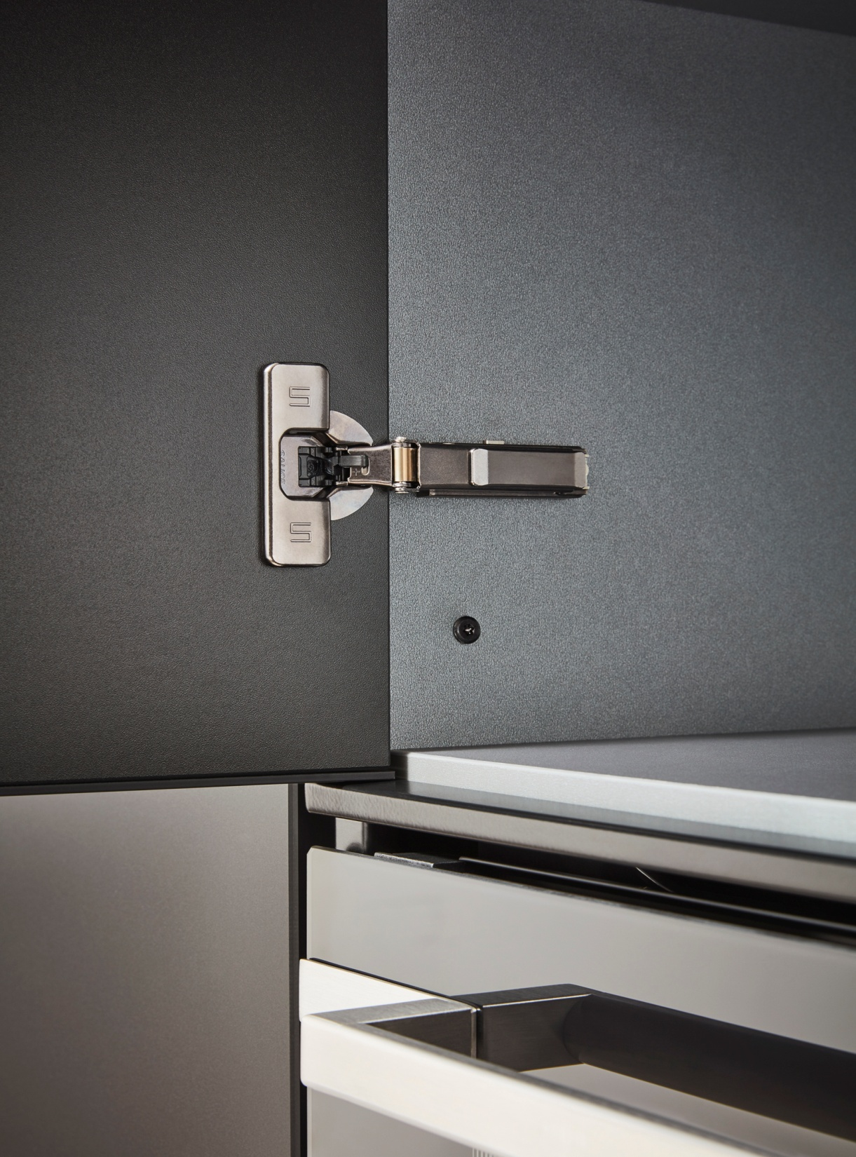
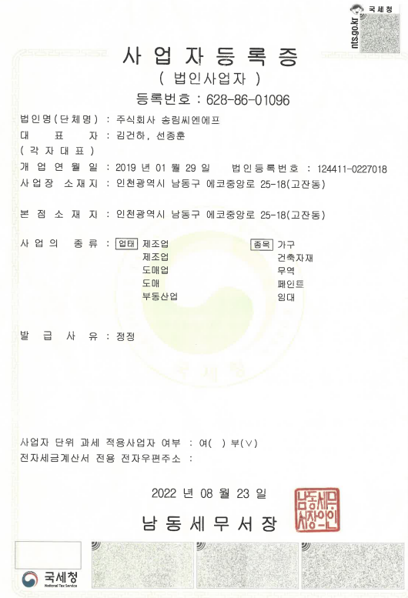
Business Registration

Slide 6
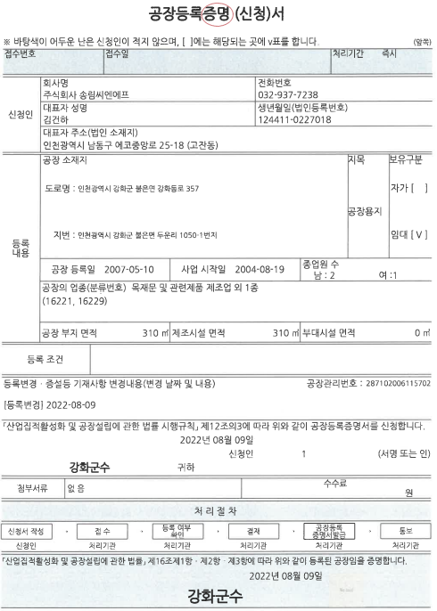
Factory Certificate

Slide 7
Local Tax Payment

Slide 8
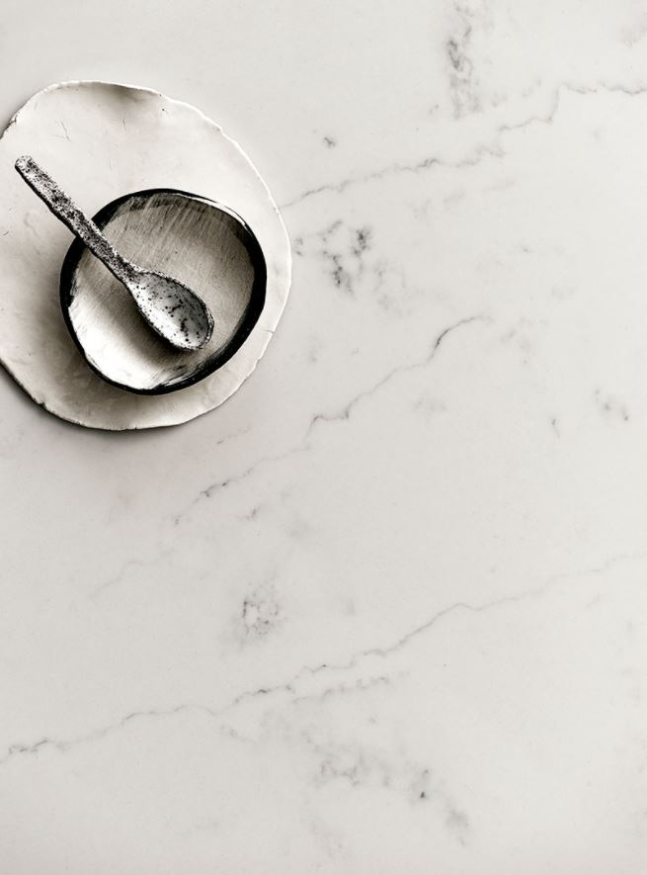
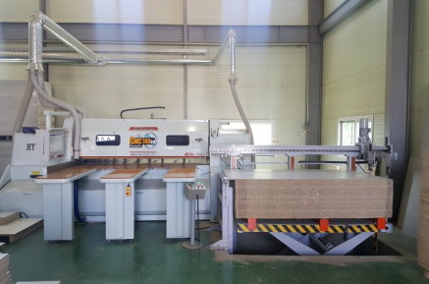
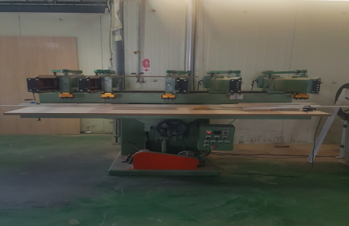
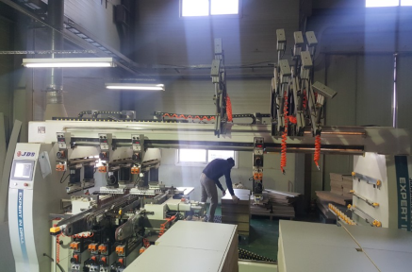
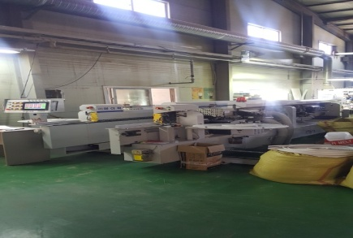
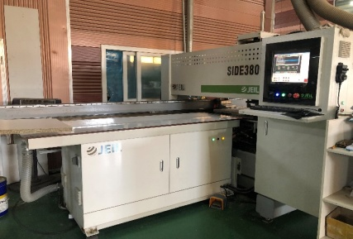
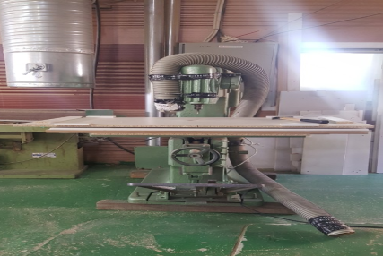
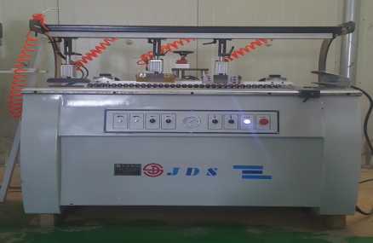
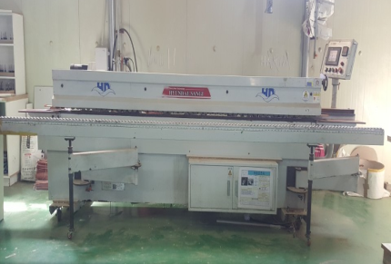
Equipments in
Possession
CNC Running Saw (CNC-HS740) – Hyundai Sangi Co
Multi Boring Machine (Z13XL) - Daewoo Wood DMC
Side Boring Machine - Daewoo Wood DMC
16th Axis Boring Machine - Daewoo Wood DMC
Double Edge Bander (APD-H21001H2) – APEX Korea
Single Edge Bander (HD-5300T) - Hyundai Sangi Co
Hanging Rail Boring Machine - Daewoo Wood DMC
Automatic Wrapping Machine – HongYoung Machinery
Router Machine -Daewoo Wood DMC
Side Plate Boring Machine (SIDE380) - Jeil Machinery
Plate Boring Machine(Z4XLCB) - Daewoo Wood DM
Forklift- TCM
Forklift- Doosan

Slide 9
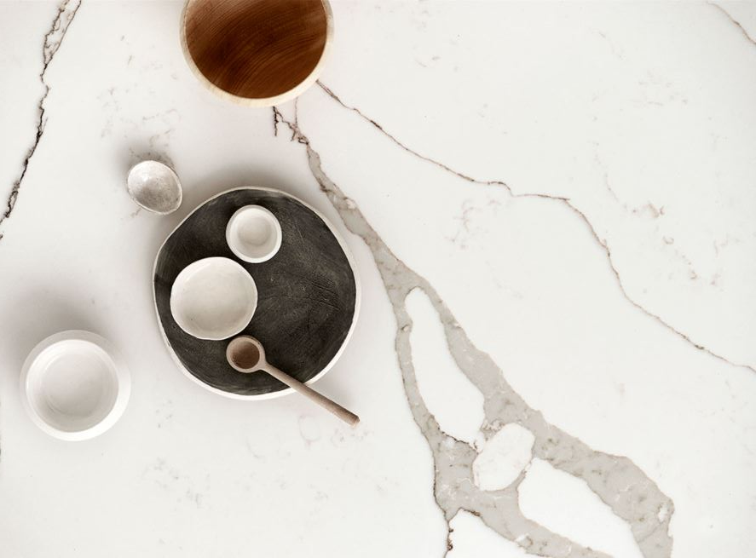
Achievements
(Number of Household Constructions)
2021
2020
Hanhwa (Michuhol, Incheon) 864 Household
Shinhan (Woldong, Siheung) 633 Household
Halla (Gam-il, Hanam) 500 Household
Youseung (Geomdan, Incheon) 938 Household
Woonam (Hang-dong, Guro) 337 Household
Hoban (Hyeon-an, Hanam) 998 Household
Kolonglobal (Beommul, Deagu) 709 Household
Hanhwa (Yeongdeungpo, Seoul) 296 Household
2019
Woonam (Sejong, KR) 290 Household

Slide 10
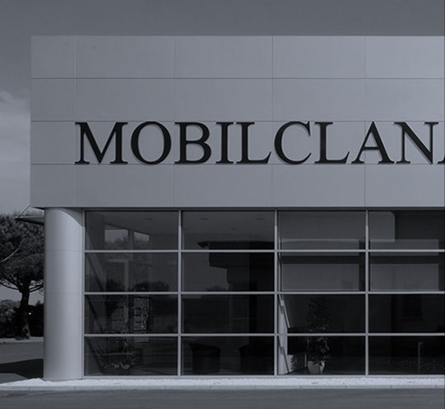
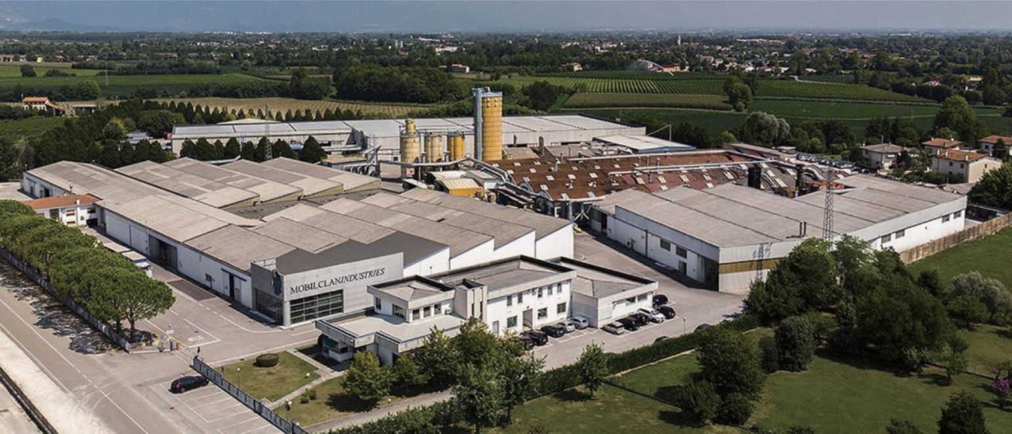
MOBILCLAN
Italian kitchen furniture
MOBILCLAN
Location
Address : Via Bruna, 23 - 31018 Calderano di Gaiarine (TV) Italy
Tel. +39 0434 766911 - Fax +39 0434 767856

Slide 11
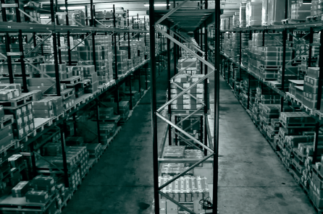
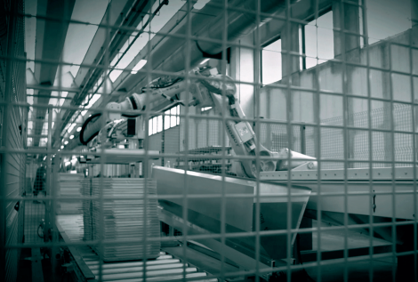
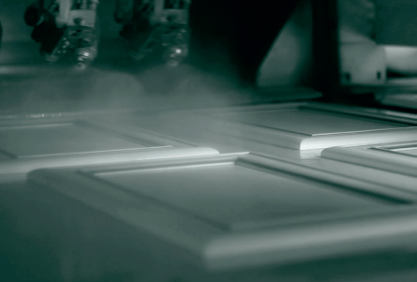
MOBILCLAN
MOBILCLAN
History
Establishment
Walter Bosa & Mario Pujatti Established
Acquisition
Euroservice S.p.A
Friulpannelli S.p.A Acquisition
Investment
Gaiarine Production Line
Remodel and Investment
Launching in KOREA
Show Room Launched in Korea, South
1975
2004
2016
1967
1980~1990
2015
2021
EXPORT
MOBILCLAN First Export Shipment
CASAITALIA
Kitchen Cabinet and Accessories
Production Line
CASAITALIA Launching
MOBILLAC
Kitchen Body-Part Assembly Line
MOBILLAC Launching

Slide 12
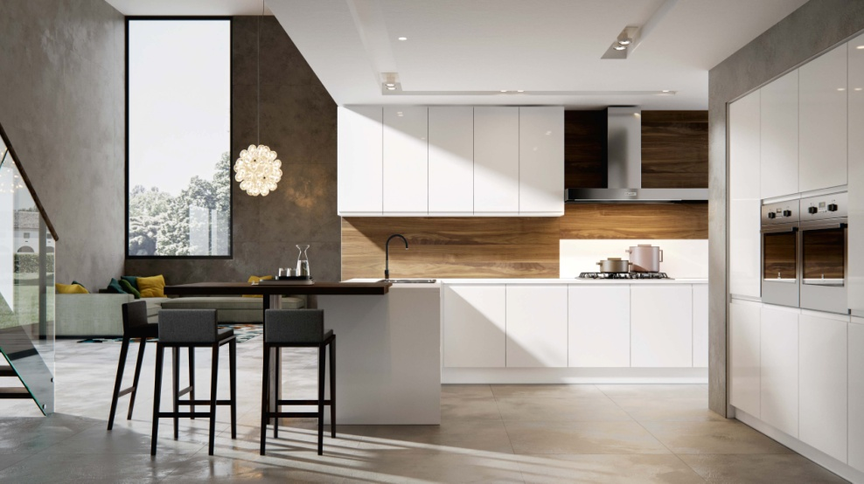
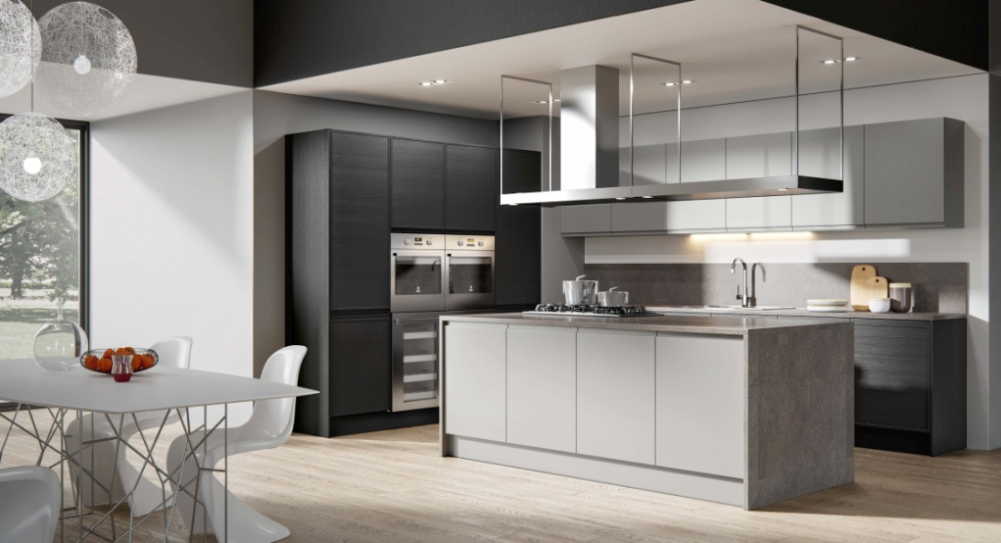
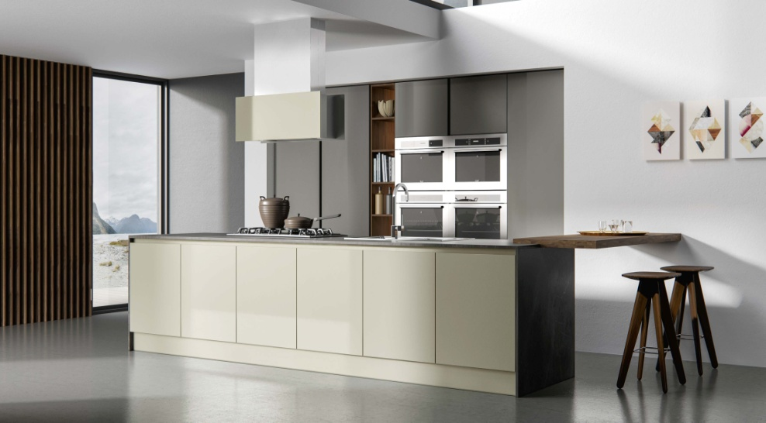
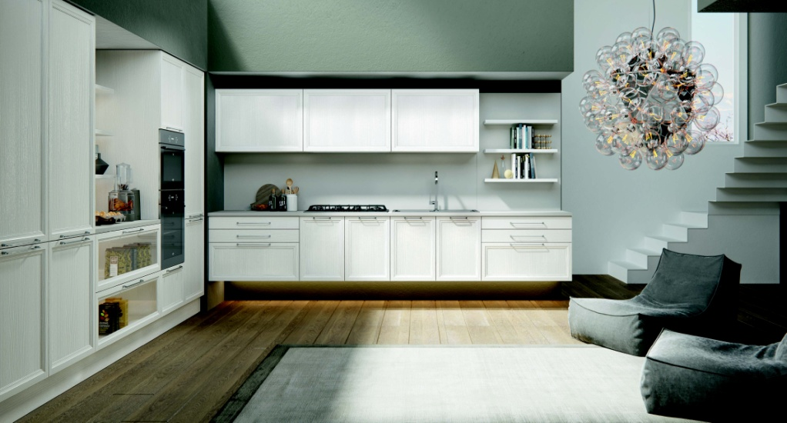
MOBILCLAN image
Kitchen & Dining

Slide 13
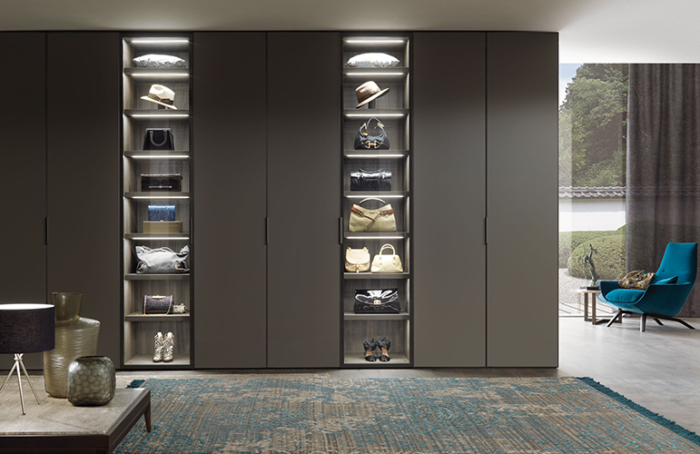
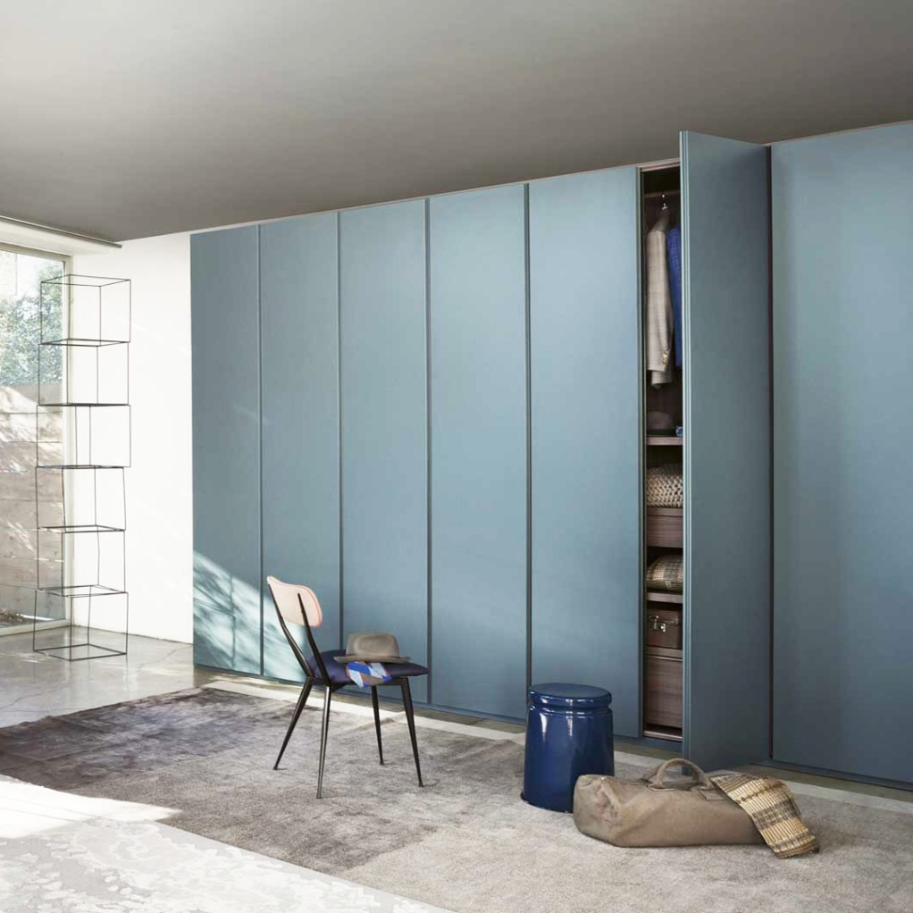
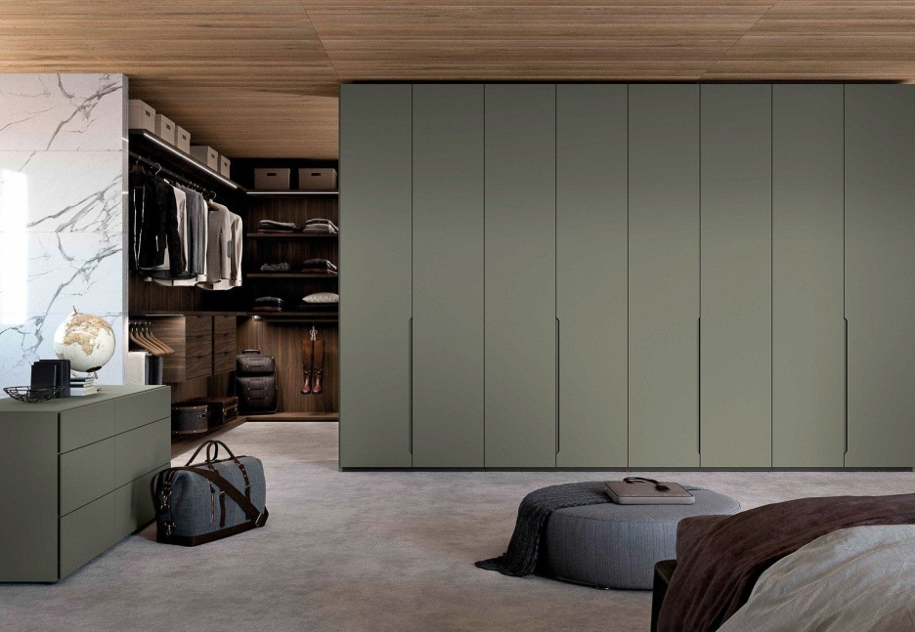
MOBILCLAN image
Wardrobes

Slide 14
web site - www.vadaraquartz.com

Slide 15
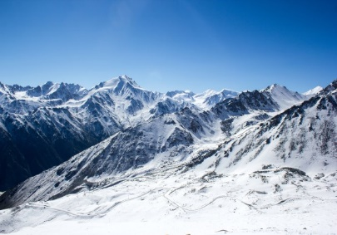
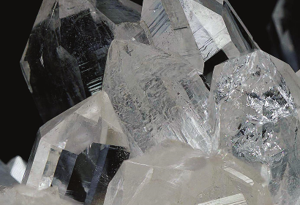
High-End Quality
From research and development to production and quality control, the source of materials and meticulous processes define the uncompromising quality of quartz surfaces.
Characteristic
Vadara is made from 99.9% high purity natural quartz and is a high-strength, non-toxic product with a natural, beautiful design.
Artistry
The inspiration for each design comes from some of the most beautiful places in the world. A design that exists forever within the color of Vadara will make your space more attractive.
Craftsmanship
Pure and natural quartz is combined with pigments, resins and exclusive craftsmanship to reflect the inspiration we find in the natural world.

Slide 16
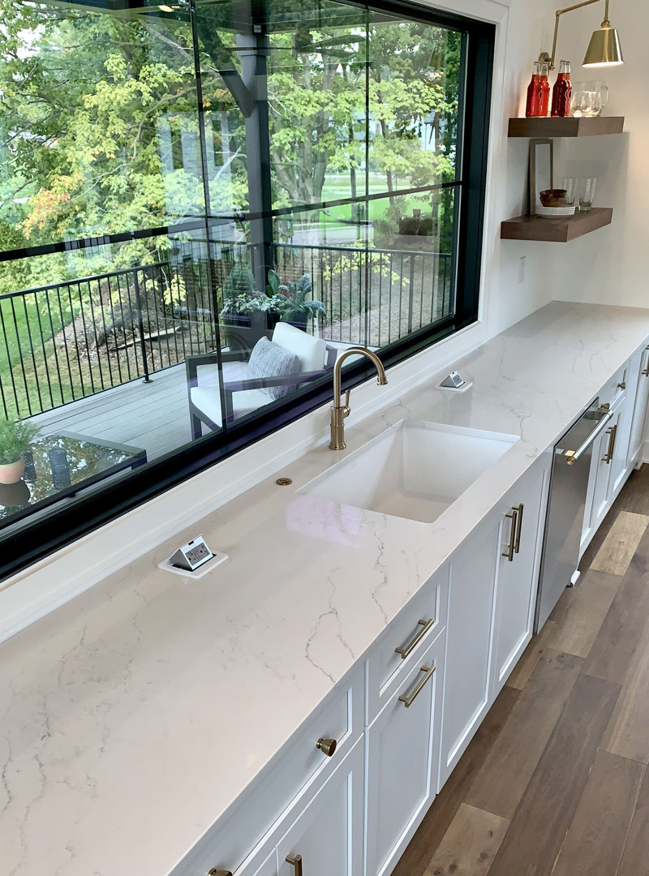

Slide 17
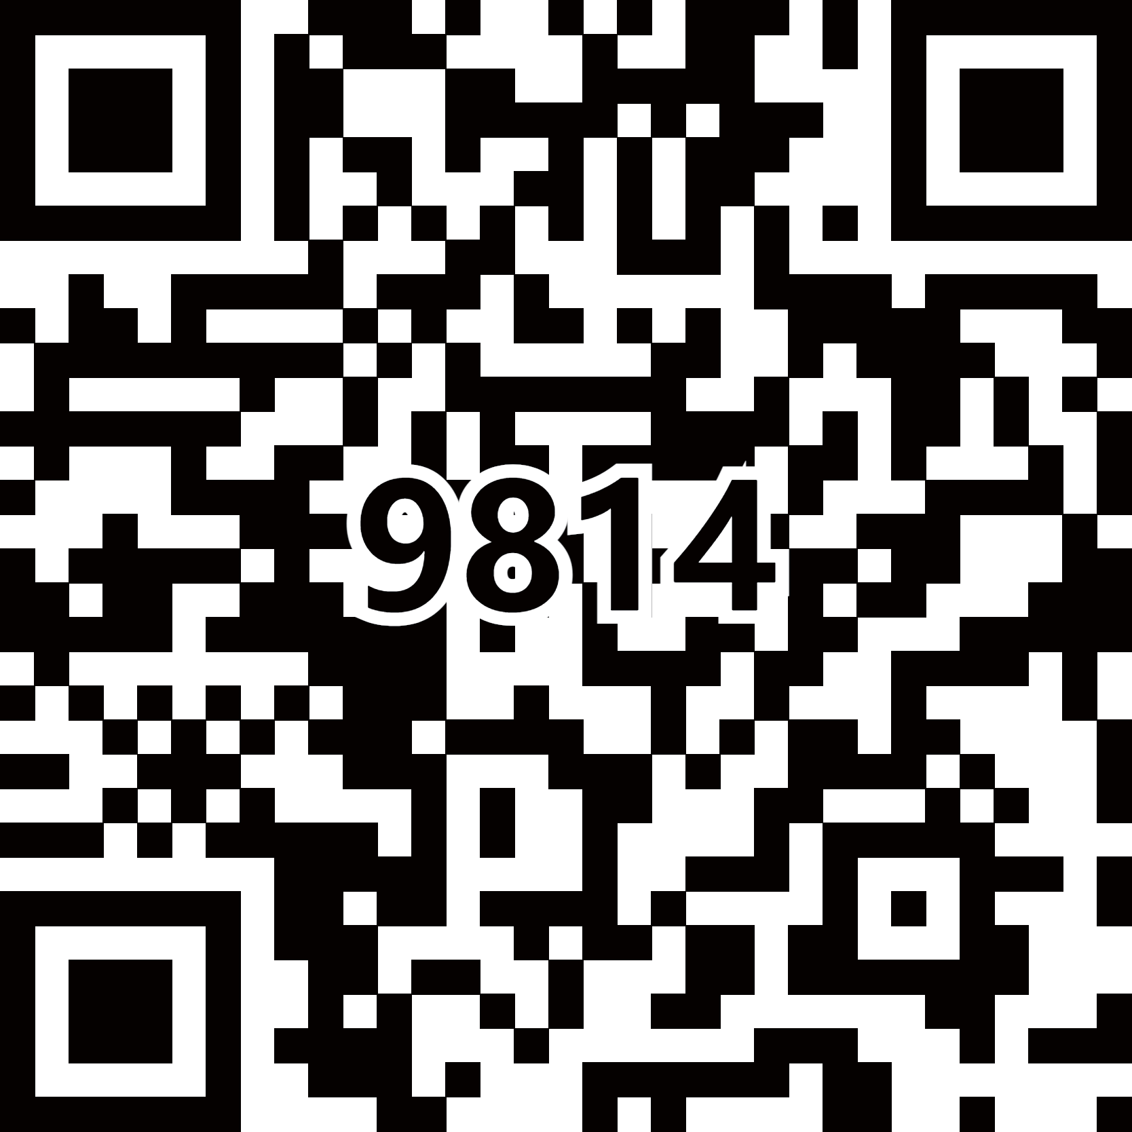
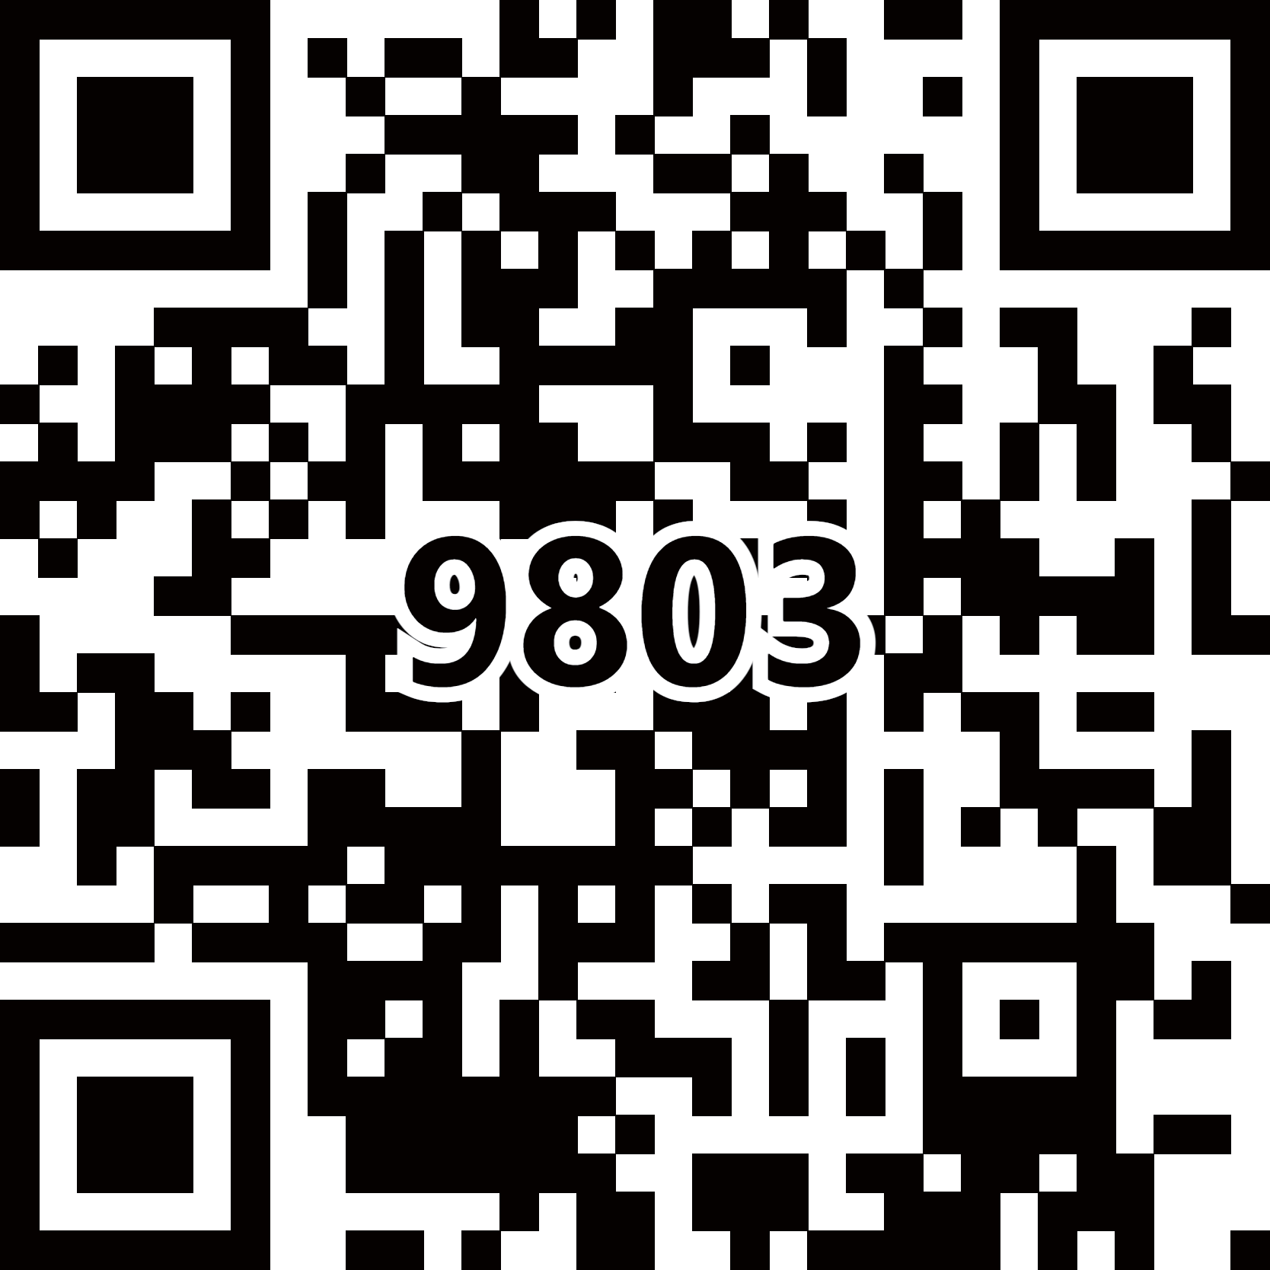
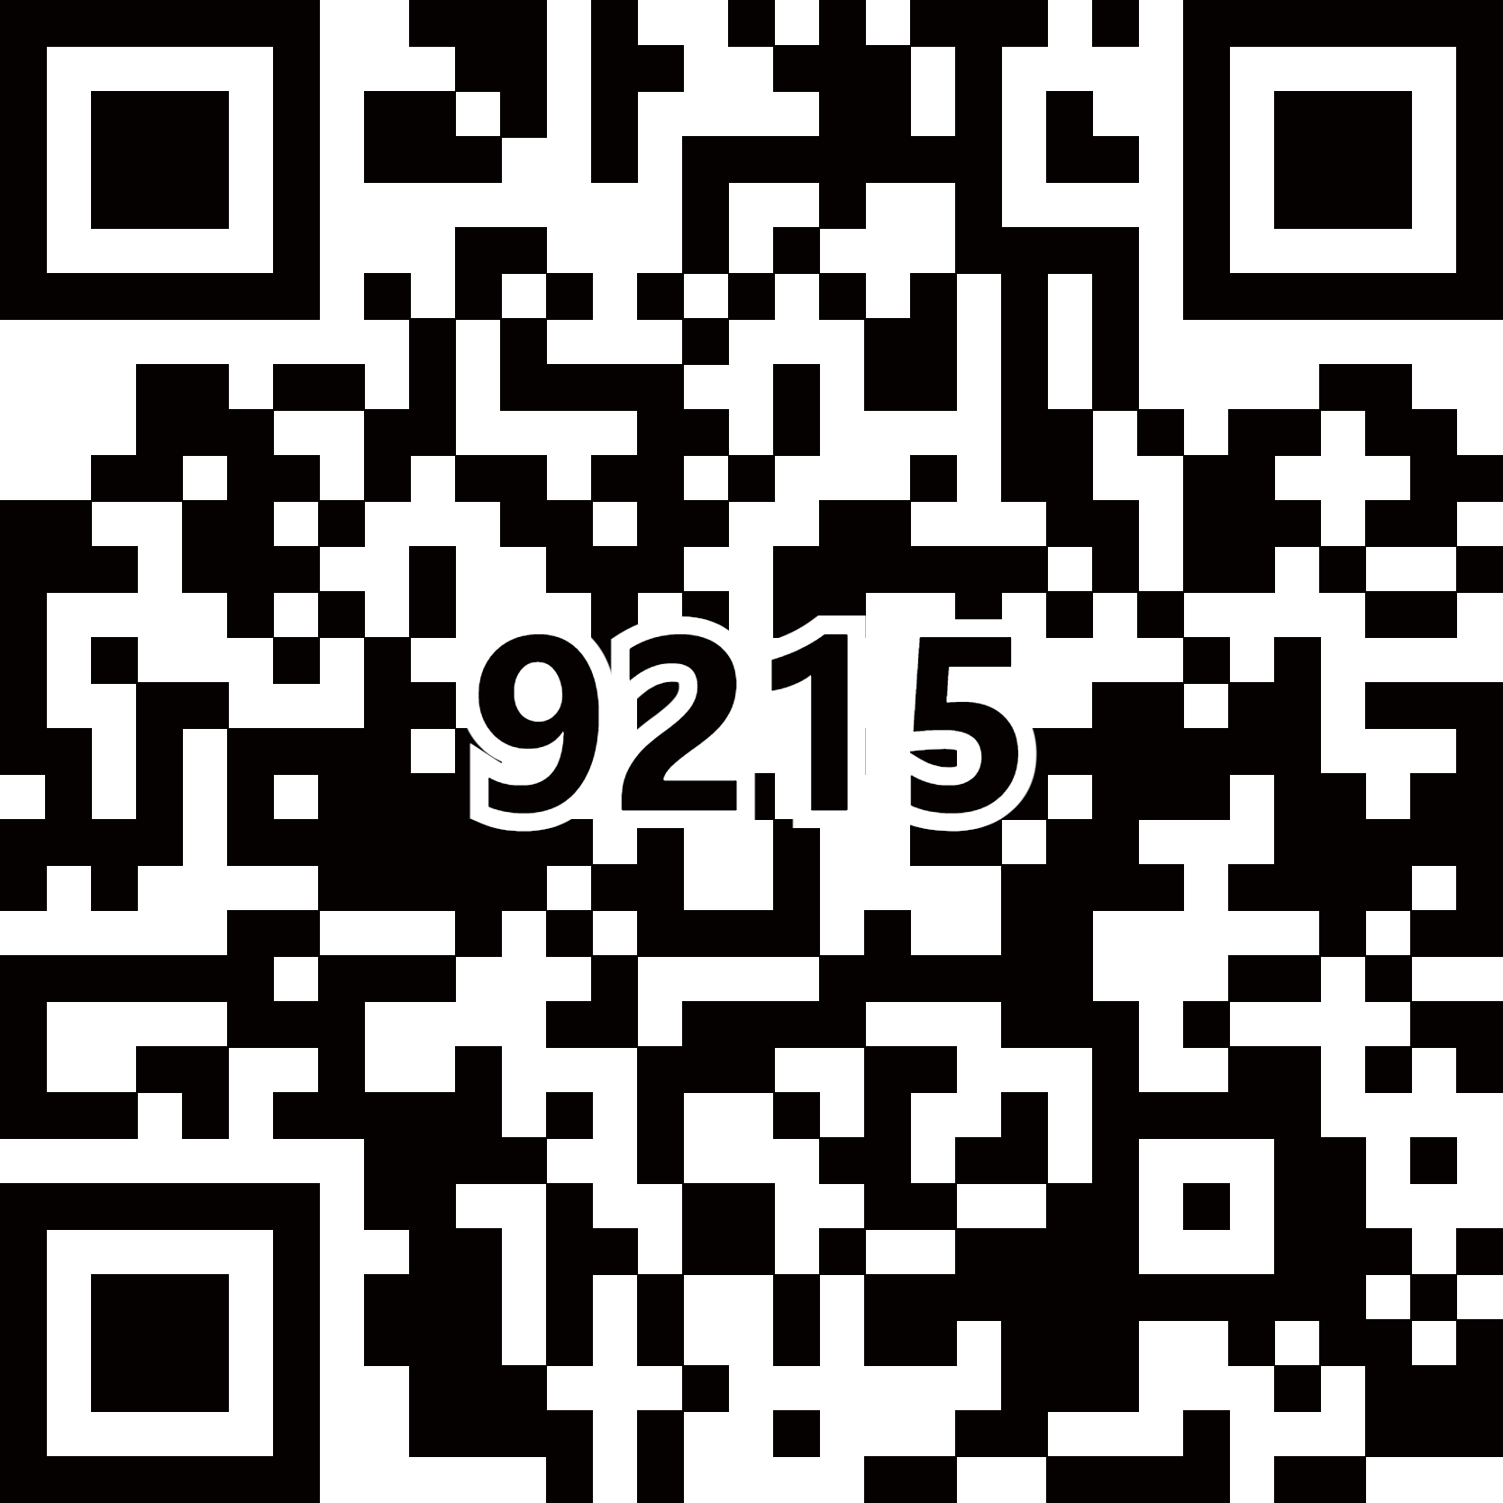
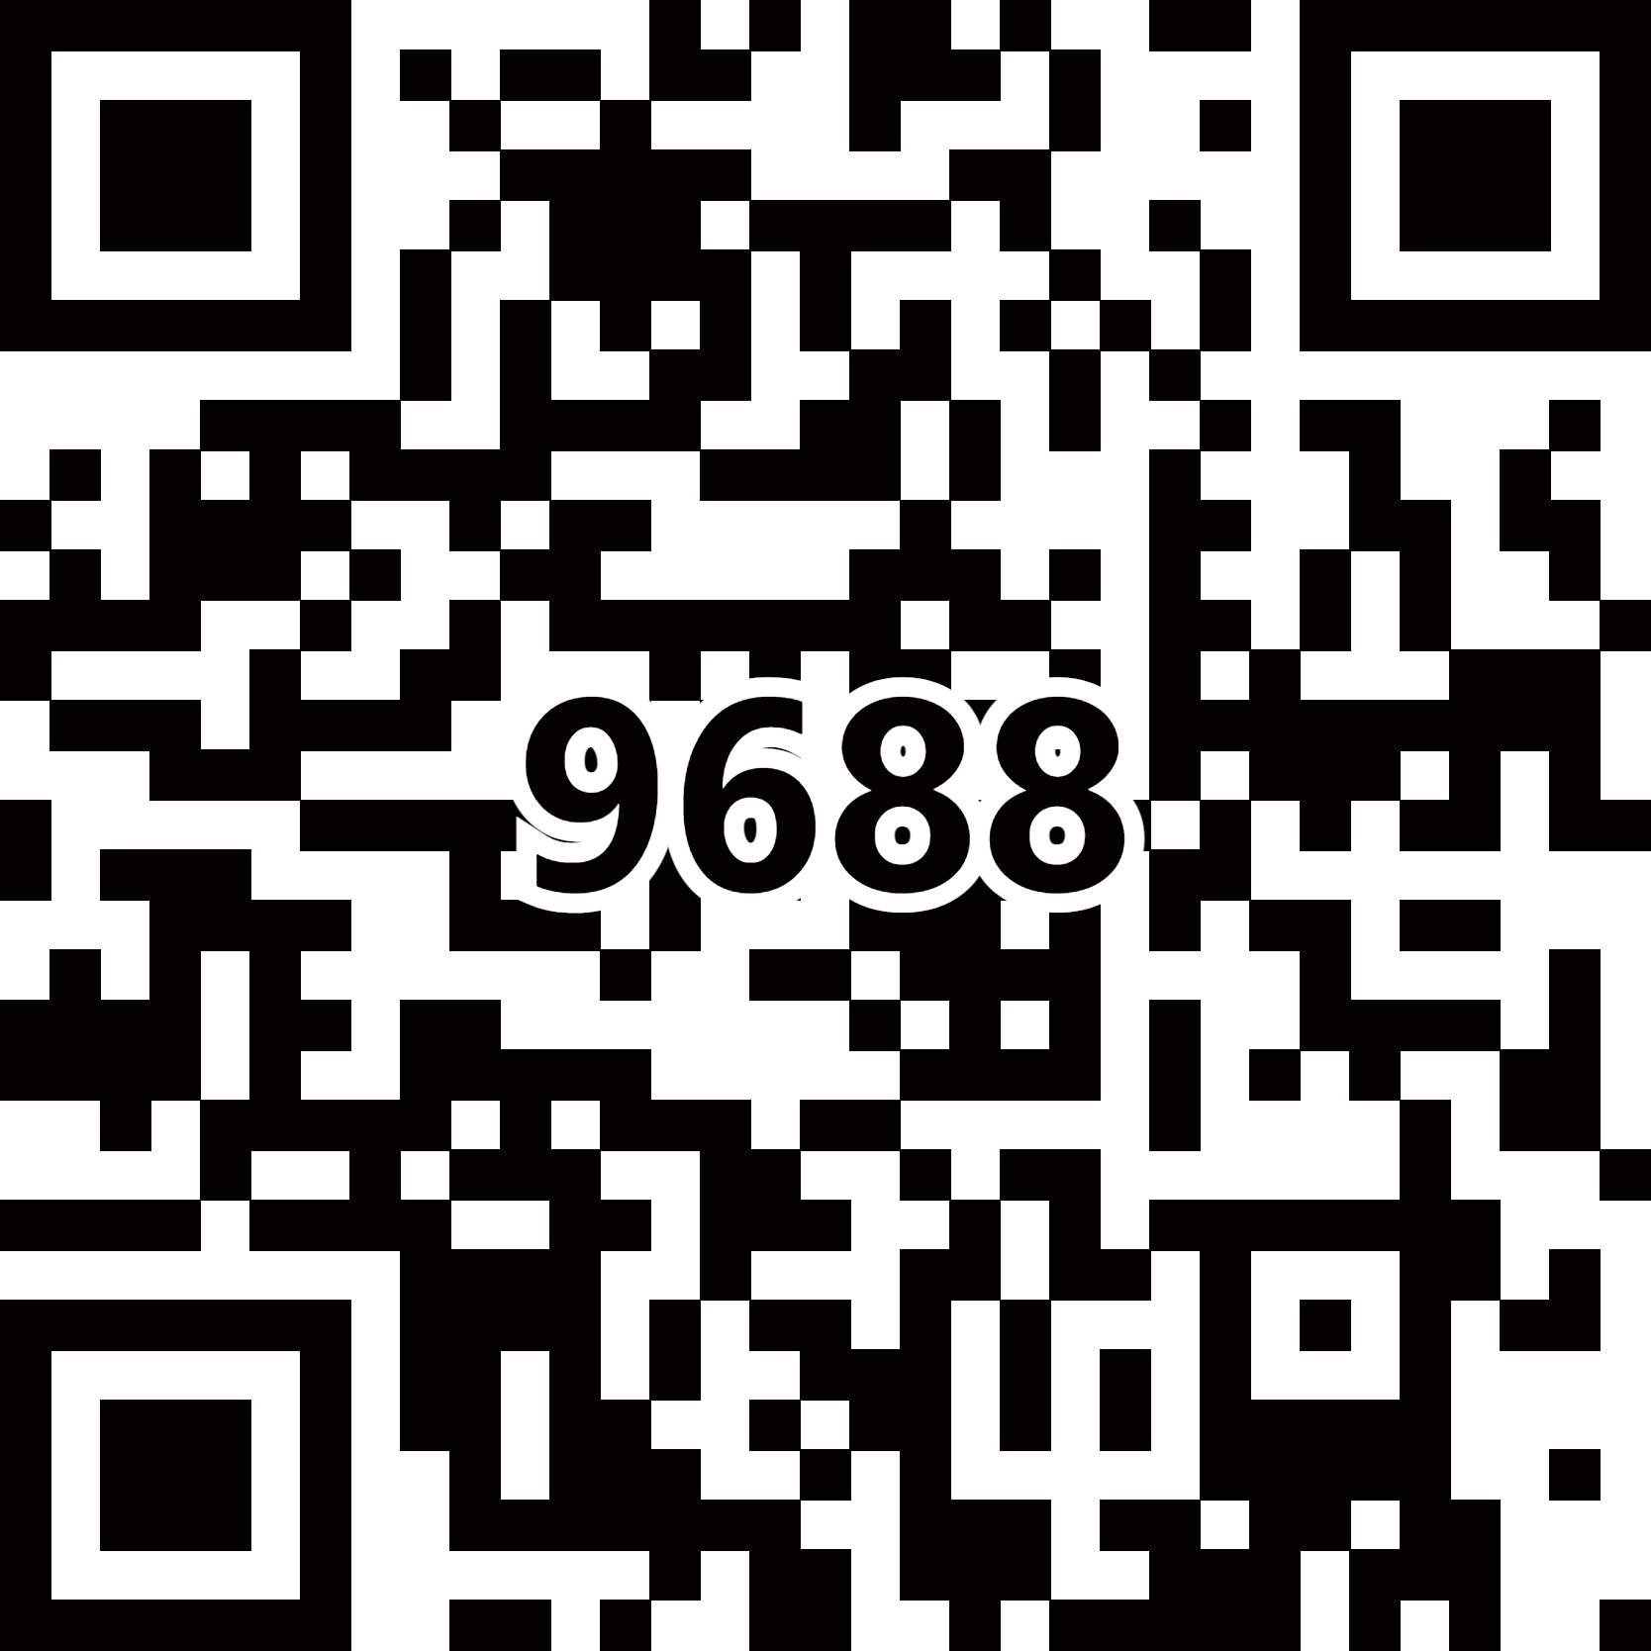
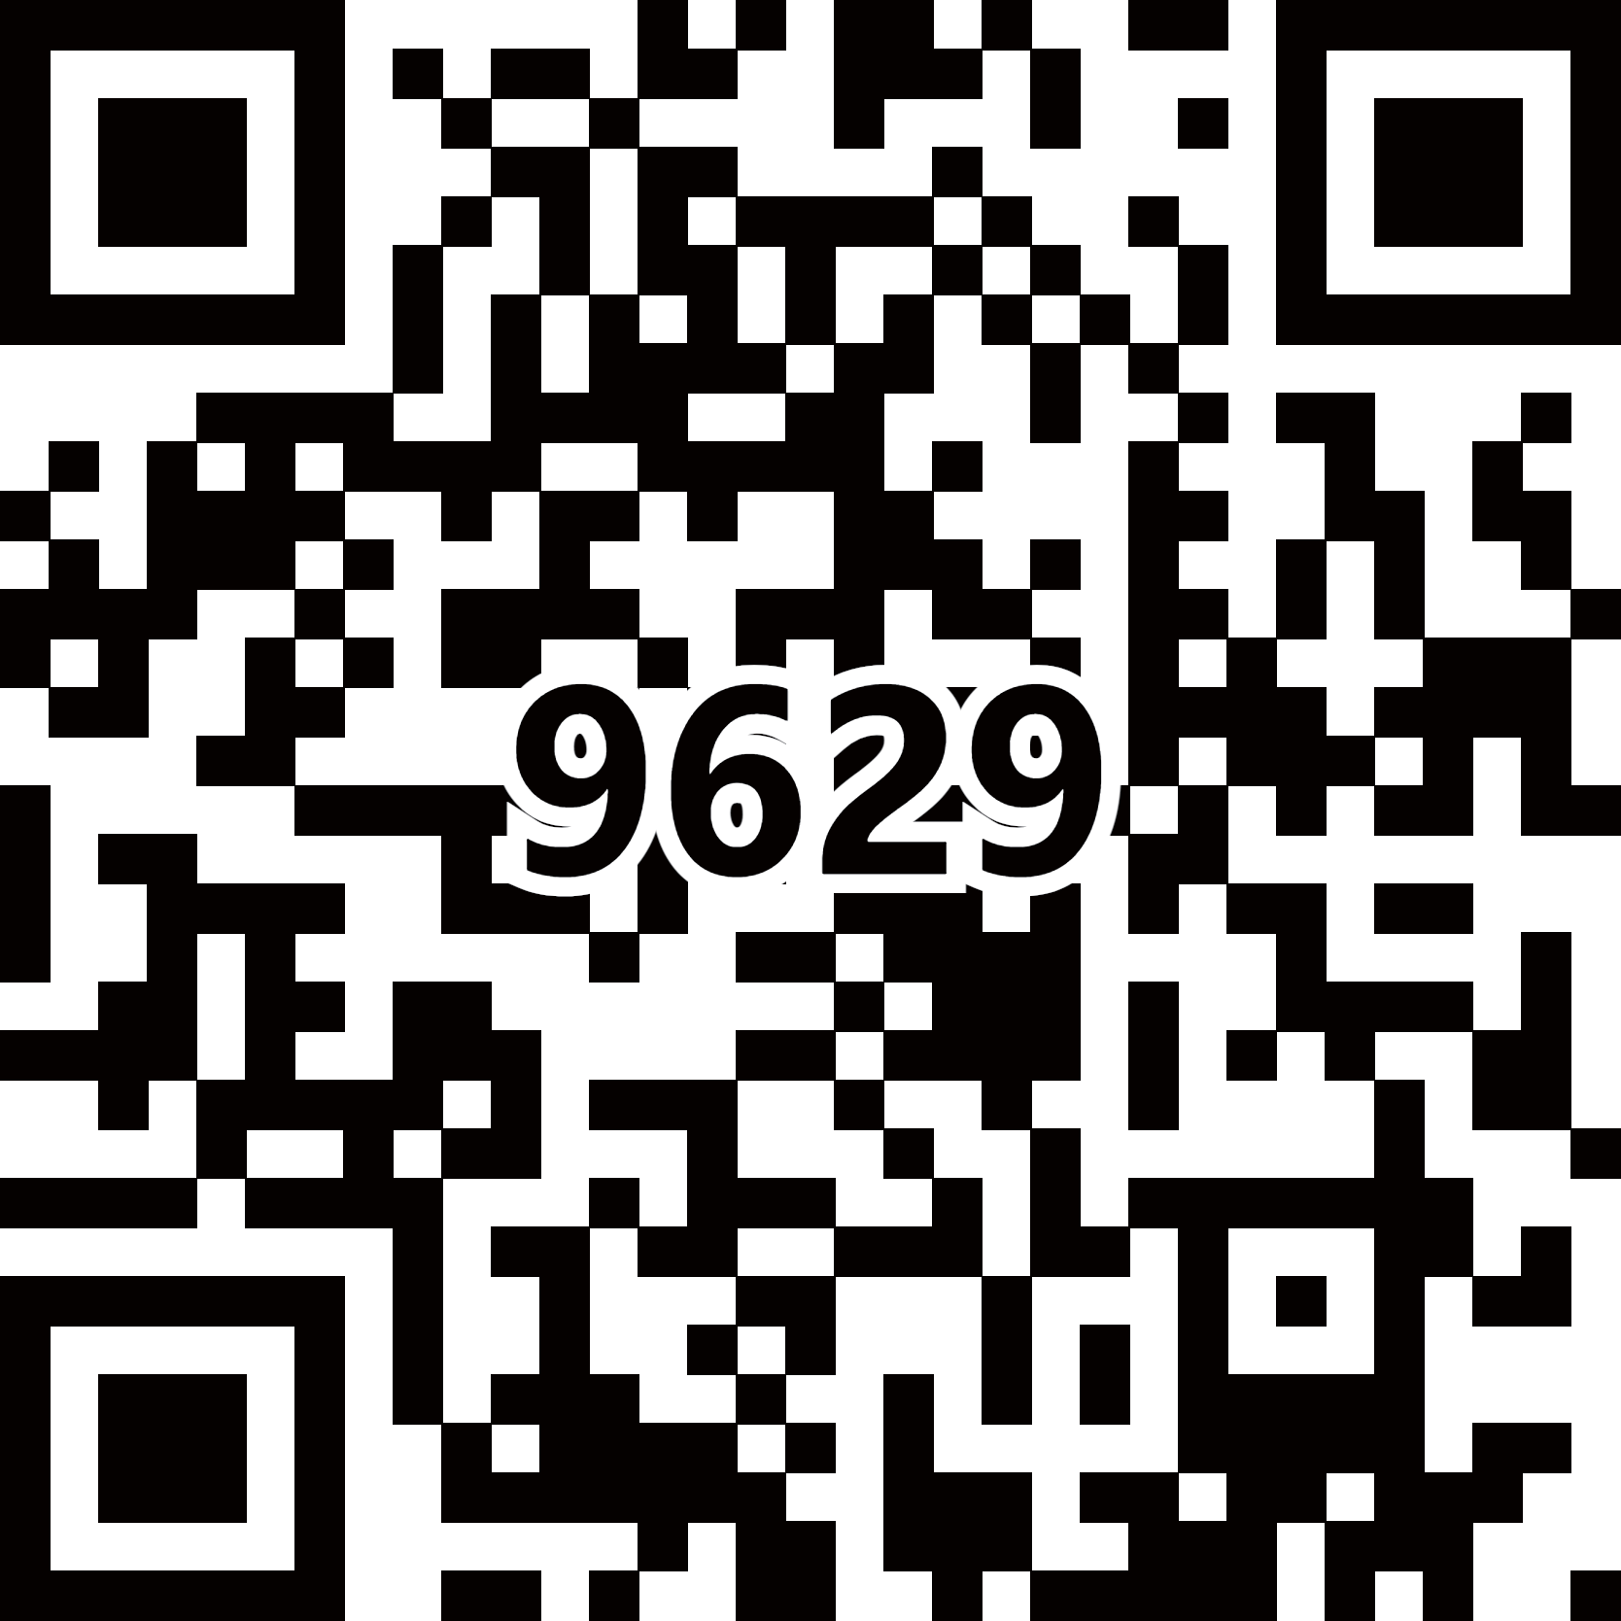
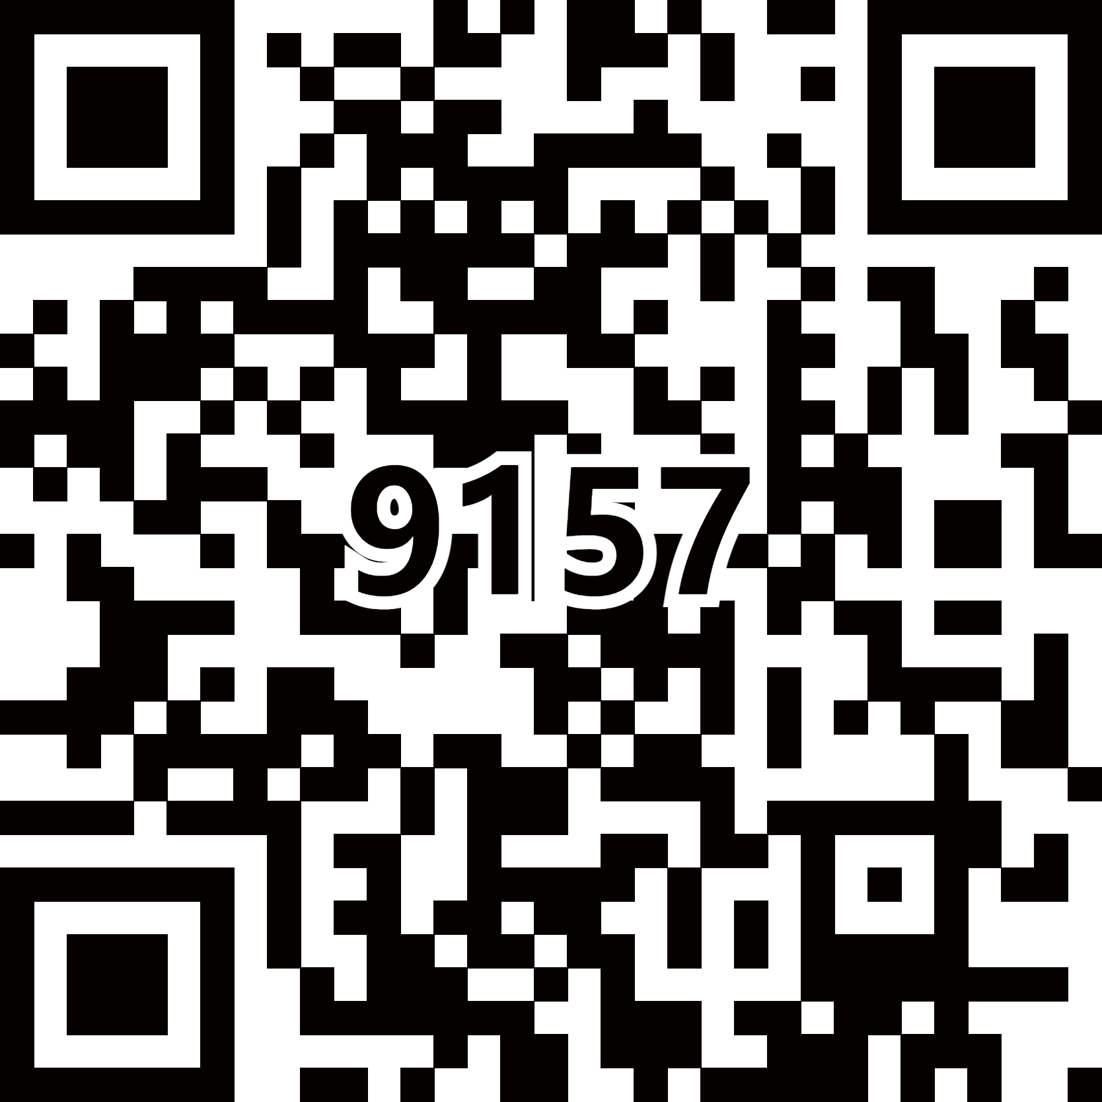
엔지니어드 스톤
엔지어드 스톤
Enlarge Image
PremiumⅠ
LE-9814K (V606)
(Naurelle Grey)
LE-9803K (V309)
(Amara)
LE-9215K
(Carrara)
LE-9688K (V312)
(Victoriano)
LE-9629K
(White Castle)
LE-9157K
(Black Shadow)

Slide 18
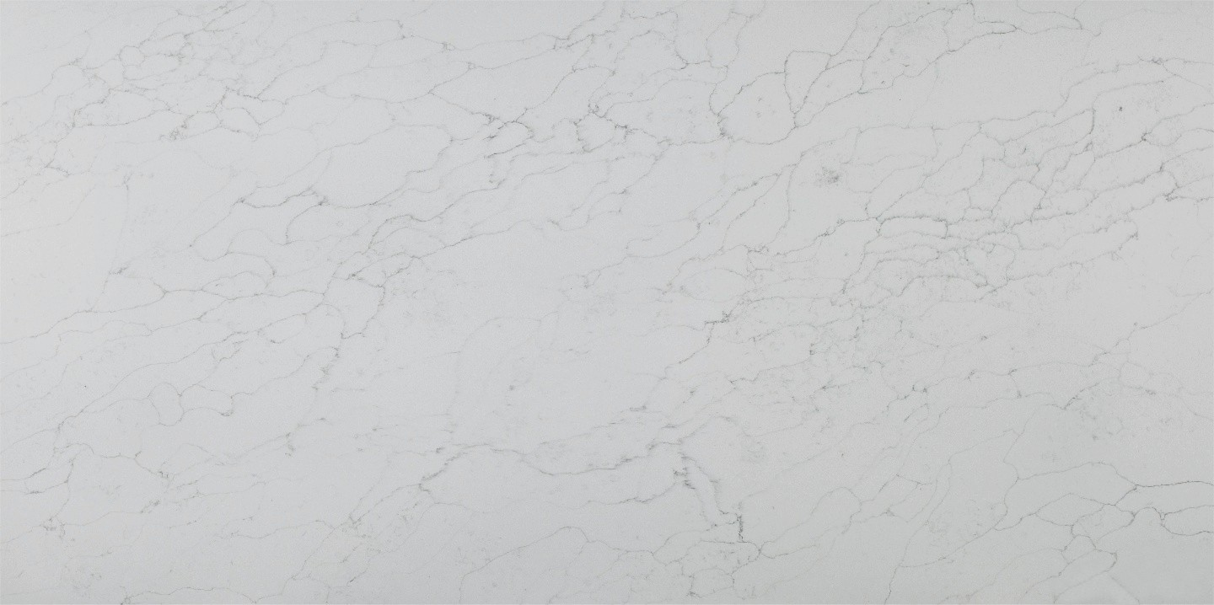
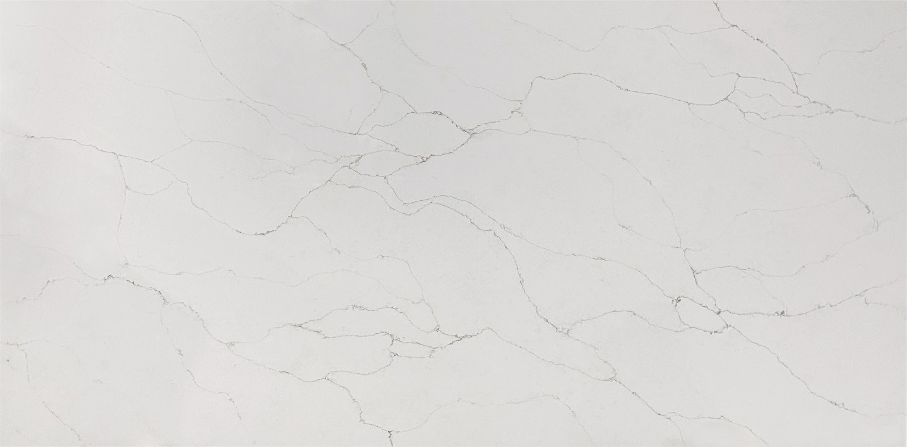
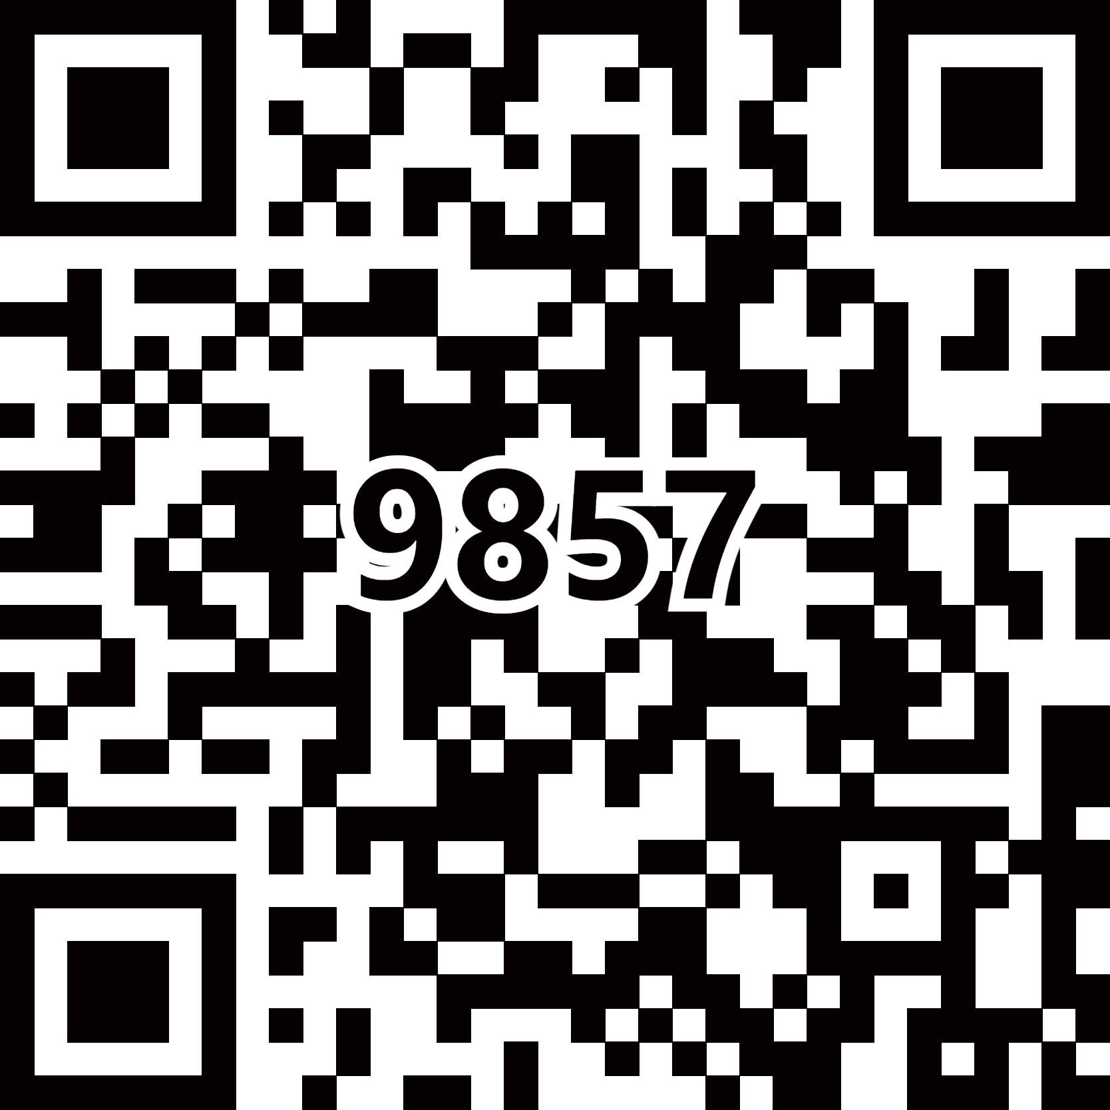
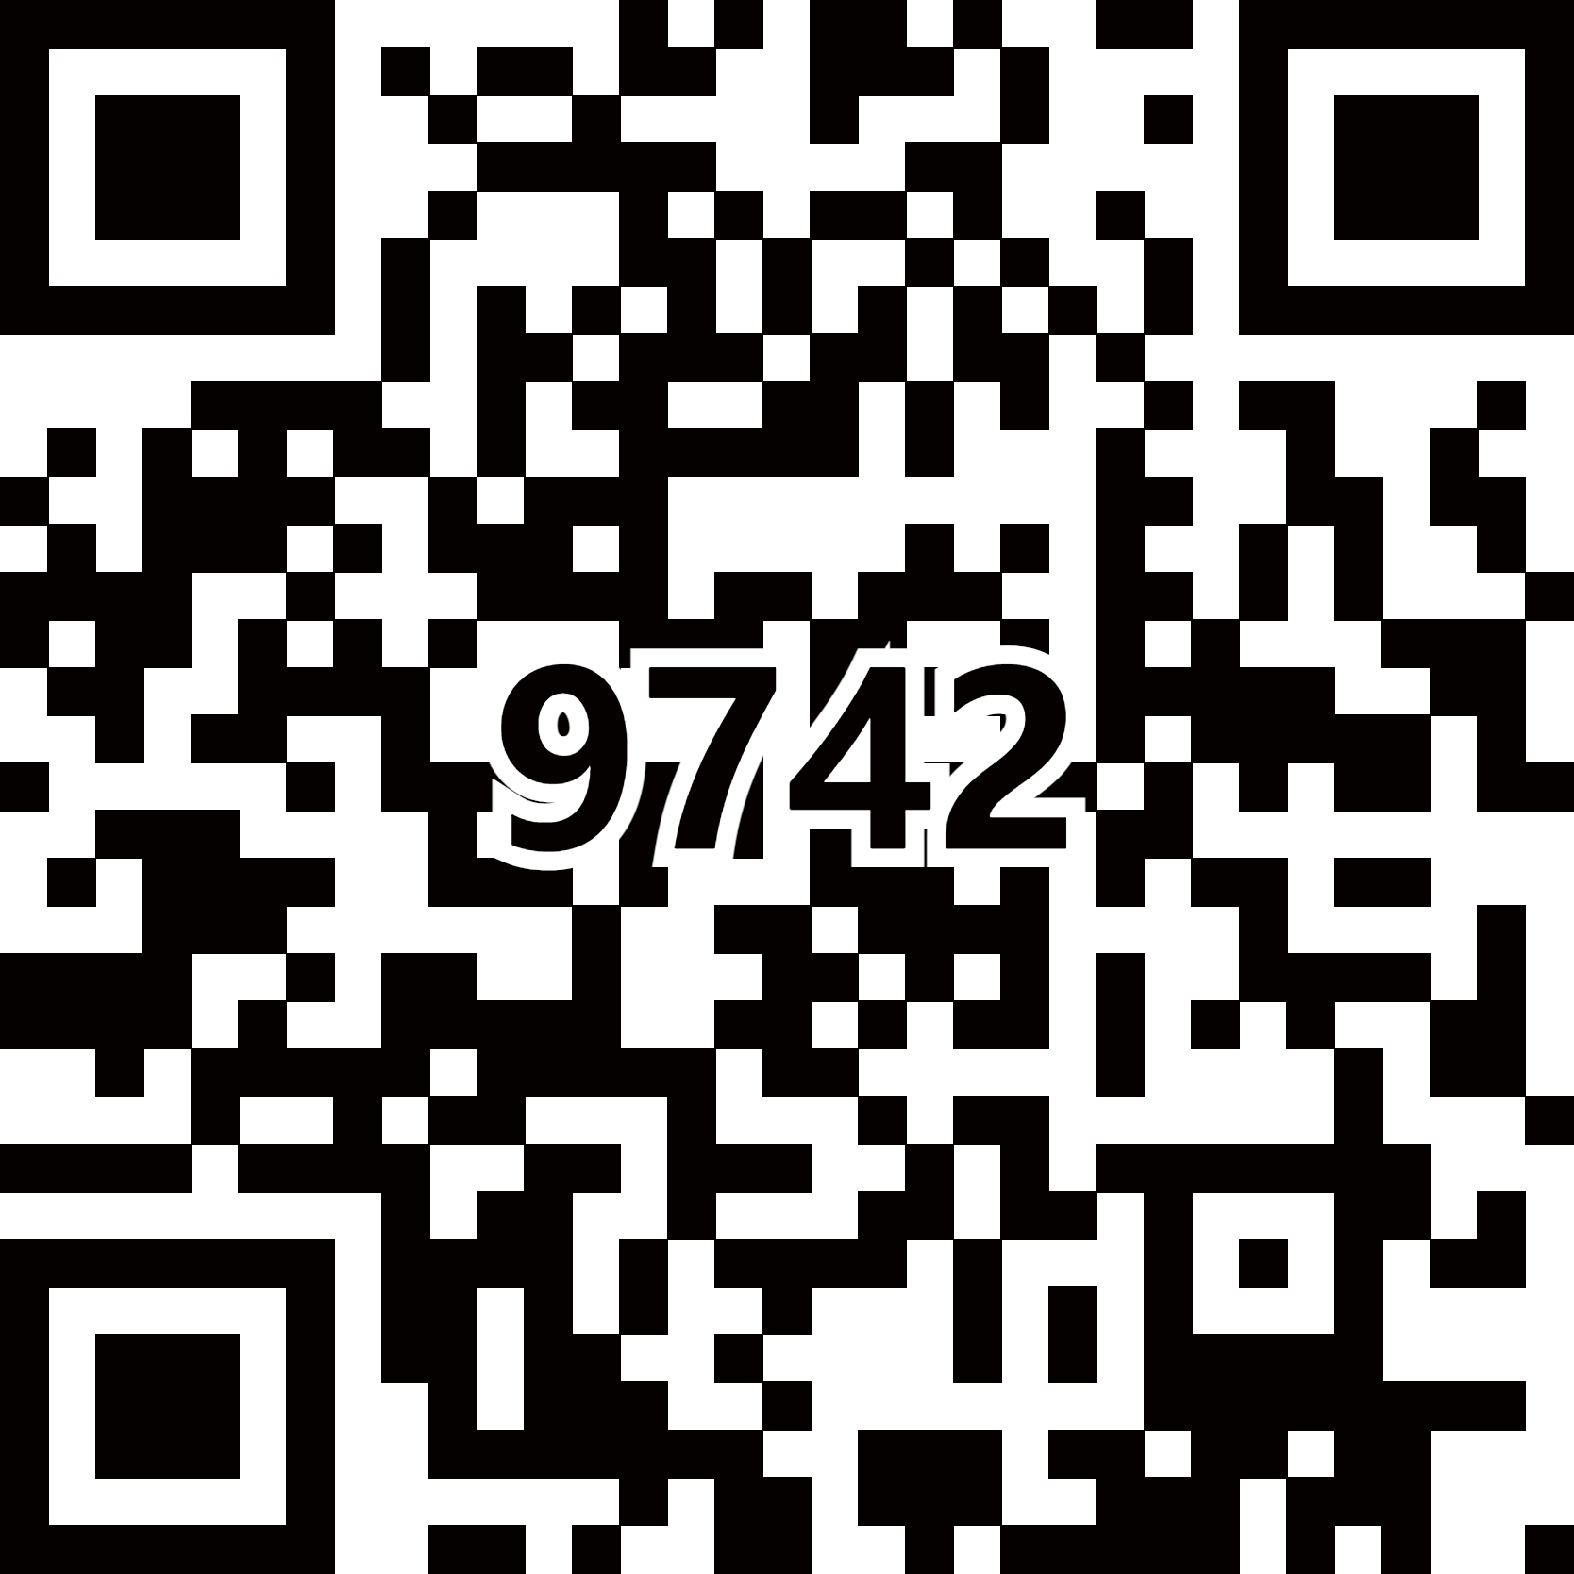
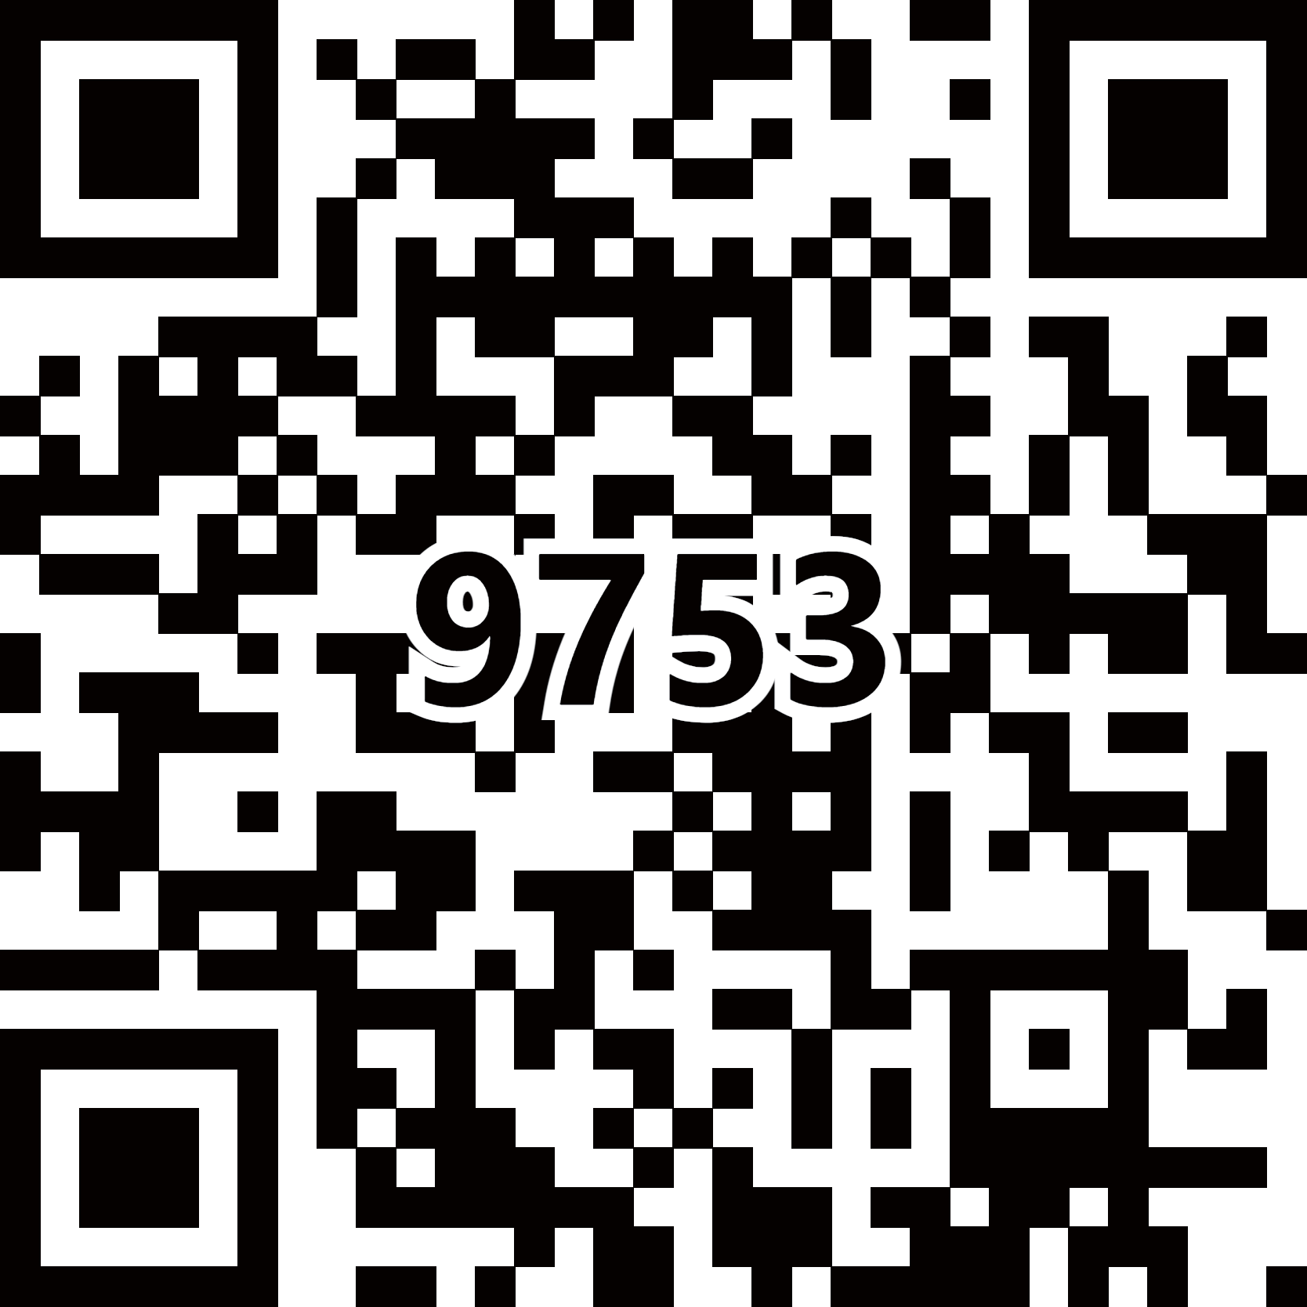
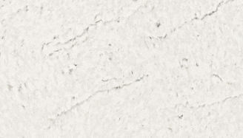
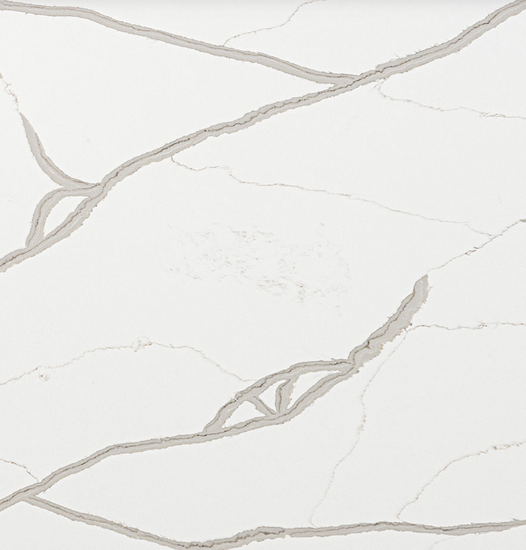
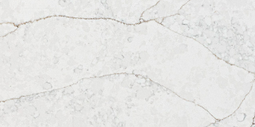
엔지니어드 스톤
엔지어드 스톤
Enlarge Image
Premium Ⅱ
LE-9857K
(Amara Black)
LE-9742K
(Avenue White)
LE-9753K
(Prado)
LE-V742
(Nimbus)
LE-V728
(Calacatta Belleza)
LE-V722
(Sereno Gold)

Slide 19
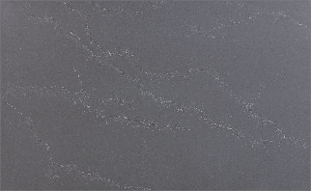
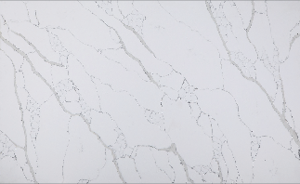
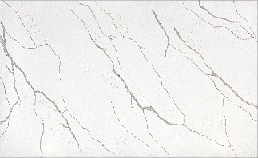
엔지니어드 스톤
엔지어드 스톤
Enlarge Image
LuxuriousⅠ
LE-9621K (V608)
(Slate Mist)
LE-9709K (V703)
(Petro Grigio)
LE-9683K
(Palmeri)
LE-9784K
(Calacatta Primo)
DUPONT 전용
LE-9742K
(Avenue White)
LE-9712K
(Versilia Grigio)

Slide 20
Major Achievement Image
Kitchen & Dining

Slide 21
Major Achievement Image
Furniture

Slide 22
Major Achievement Image
Dress Room

Slide 23
Major Achievement Image
Resort & Hotel

Slide 24
Major Achievement Image
Resort & Hotel

Slide 25
Major Achievement Image
Resort & Hotel

Slide 26
Major Achievement Image
Resort & Hotel

